Slide 1
E-Catalogue
（Issue 47）

Slide 2
Contact
Shenzhen YuanGuangHao Electronics Co.,Ltd
contact: Susan
Tel：0755-28689196
Fax：0755-28662790
Add：No.7 Building Lian Yi Street, Tang Keng Rd,
Liu Yue HengGang town, Long Gang District,
ShenZhen, China
Mobile phone: +86 15814077179
E-mail：susan@yghao.com

Slide 3
2022 Newest products
1

Slide 4
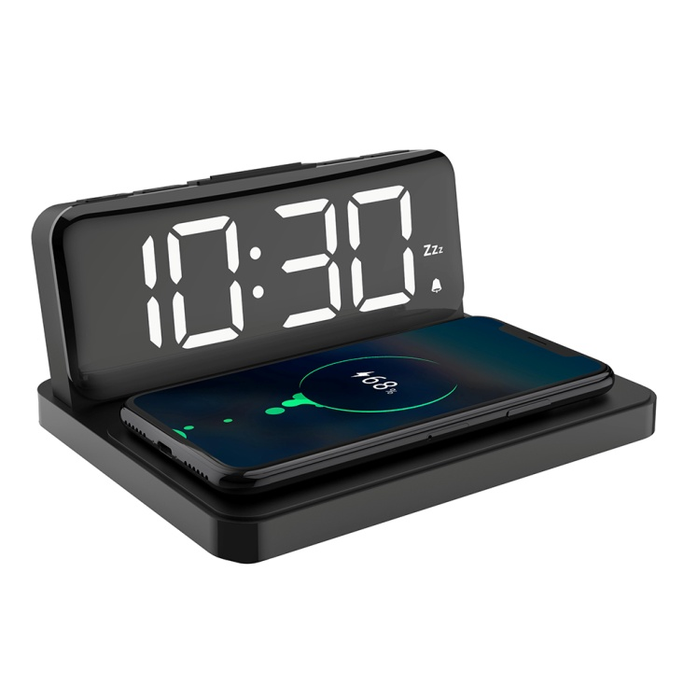
YGH-5279 Two in One Wireless Charger Clock
2022 Newest
Features:
Wireless charging function: 15W for phone fast charging,
USB output (5V/1A);
LED display screen;
Brightness adjustment
Clock setting; 12/24 hour format;
Alarm setting (1 group, BBB sound); Snooze setting;
Volume adjustment( loud, low voice)
Specification:
Inout interface: Type-C
Power supply: adapter ( exclude)
Input voltage and current: 5V-2A, 9V-1.67A, 12V-1.5A;
Output power: 5W/7.5W/10W/15W
Frequency: 110～205KHZ;
Conversion efficiency: 75%～85%Max
Charging induction distance: 3-8mm
Material:ABS
Product weight :236g
Q‘ty:3000pcs
FOBSZ Price: USD12.7/PC

Slide 5
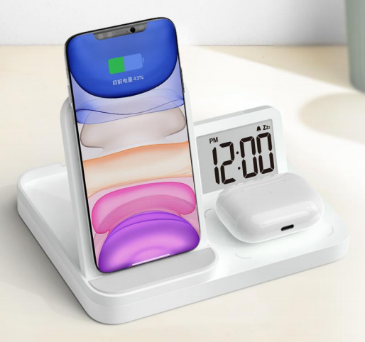
YGH-5271 Three in one wireless charger clock
Features:
Wireless charging function: 15W for phone fast charging, 5W for earphone charging, USB output ;
LCD display; with orange backlight;
Clock setting; 12/24 hour format;
Alarm setting (1 group, BBB sound 80-dB); Snooze setting;
Power-off time memory function;
Specification:
Input voltage and current: 5V-2A, 9V-1.67A, 12V-1.5A;
Output power: 5W/7.5W/10W/15W;
Frequency: 110～205KHZ;
Conversion efficiency: 75%～85%Max
Material:ABS
Packaging Info:
Carton size : 36*34*37 cm
G.W: 13.9KG
N.W: 13.1KG
Q’TY: 40pcs
2022 Newest
Amazon exclusive
Q‘ty:3000pcs
FOBSZ Price: USD12.7/PC

Slide 6
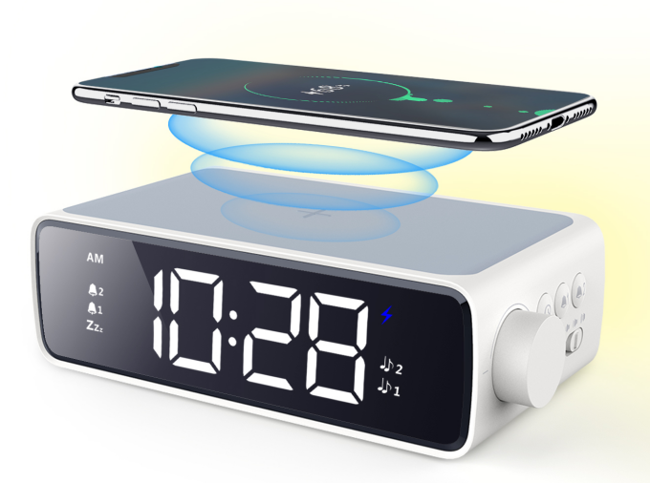
YGH-5265 Wireless charging nightlight alarm clock
Features:
Large LED display;
Clock setting; 12/24 hour format;
2 Group Alarm setting;3 Group ringtones selection;
Snooze setting;
Brightness adjustment;
Nightlight adjustment;
10W fast wireless charger function
Power-off time memory function;
Specification:
Product size:164*87*50mm
Material:ABS
Product weight :255g
Packaging Info:
Carton size : 40.5*32*31cm
G.W: 10.9KG
N.W: 10.2KG
Q’TY: 30pcs
2021 Newest
Amazon exclusive
Q‘ty:3000pcs
FOBSZ Price: USD12.7/PC

Slide 7
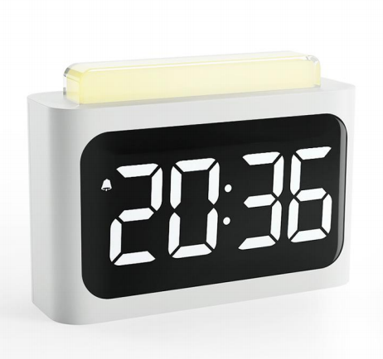
YGH-5269Human body induction clock
Features:
Large LED display;
Clock setting; 12/24 hour format;
2 Group Alarm setting;2 Group ringtones selection;
Snooze setting;
3 volumes selection:High-Middle-low;
Nightlight + colorful light adjustment;
Power-off time memory function;
Specification:
Product size: 128*92*41.5mm
Material:ABS
Product weight : 158.5g
Packaging Info:
Carton size : 57*41*23 cm
G.W: 12.9KG
N.W: 12.1KG
Q’TY: 40pcs
2022 Newest
Amazon exclusive
Q‘ty:3000pcs
FOBSZ Price: USD8.5/PC

Slide 8
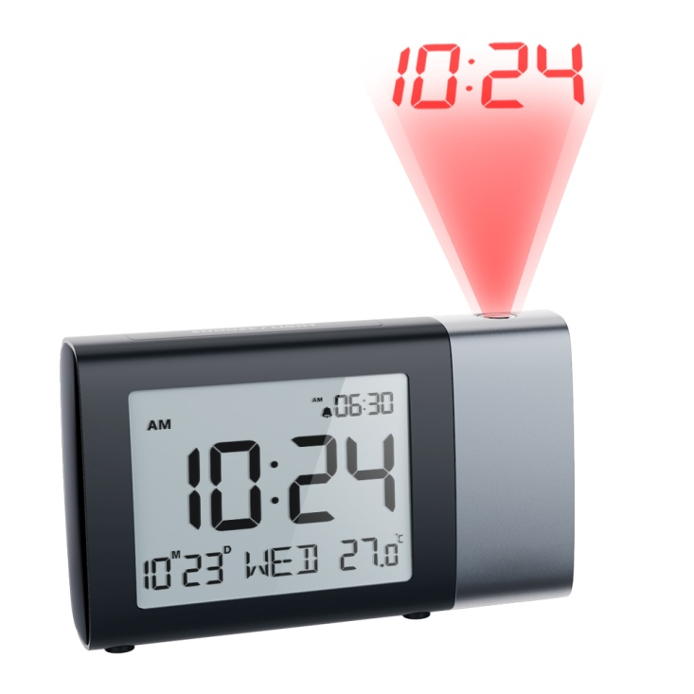
YGH-5282 Projection Clock
2021 Newest
Features:
Clock setting: 12/24 hour format;
Alarm setting (1 group), Snooze function
Volume adjustment(L01, L02)
With weekend mode
Calendar function
Temperature measurement (0℃ to 50℃)
Time projection function
With backlight
Specification:
Inout interface: Micro USB
Power supply: 3pcs*AAA battery or Adapter (exclude)
Material:ABS
Amazon exclusive
Q‘ty:3000pcs
FOBSZ Price: USD9.5/PC

Slide 9
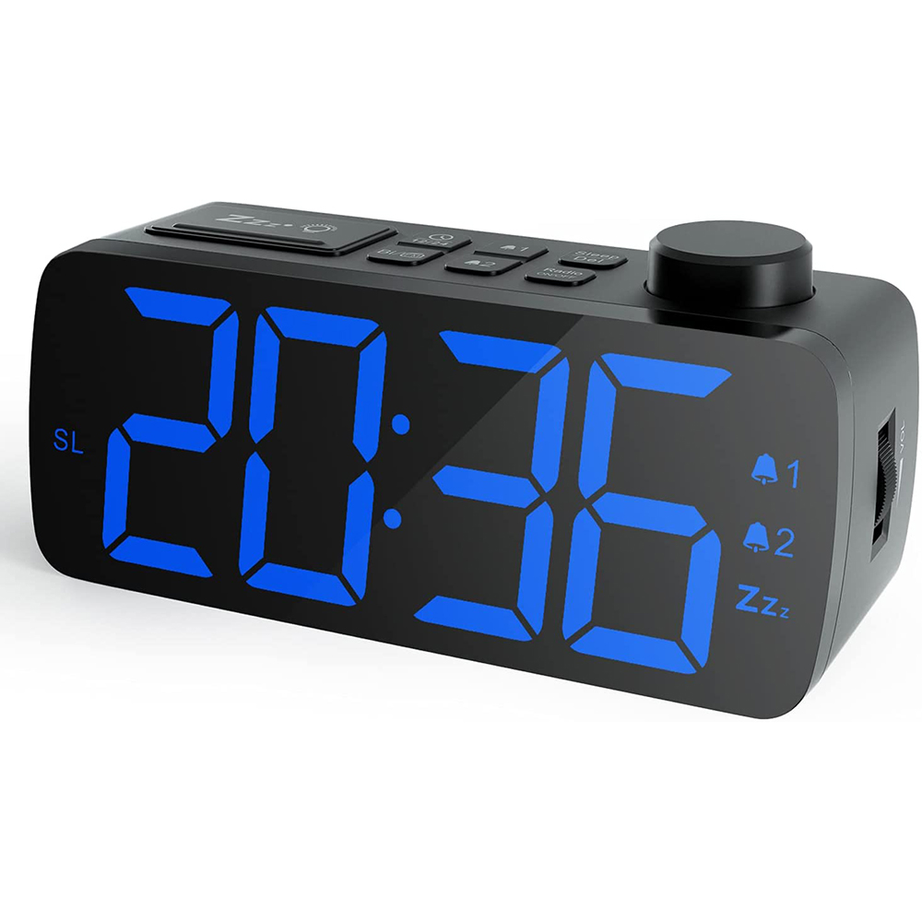
YGH-5230FPro 收音机时钟
Product features:
Brightness adjustable: screen 4 block adjust brightness
Time function: 12/24 hour system conversion
Alarm function: Set two alarm clocks
Noise volume: small/medium/large volume
Snooze function: 9 minutes later the alarm again
Radio mode: auto search, auto store up to 50
Specification:
size: : 156*64*55cm
Product weight: 218g
Material : ABS/PC
Battery type:1*3V CR2032 button battery (included)
Packaging Info:
Carton size : 39.5*32*36cm
G.W: 12.46 KG
N.W: 11.6KG
Q’TY: 40PCS
2022年新品
Q‘ty:3000pcs
FOBSZ Price: USD9.5/PC
Amazon exclusive

Slide 10
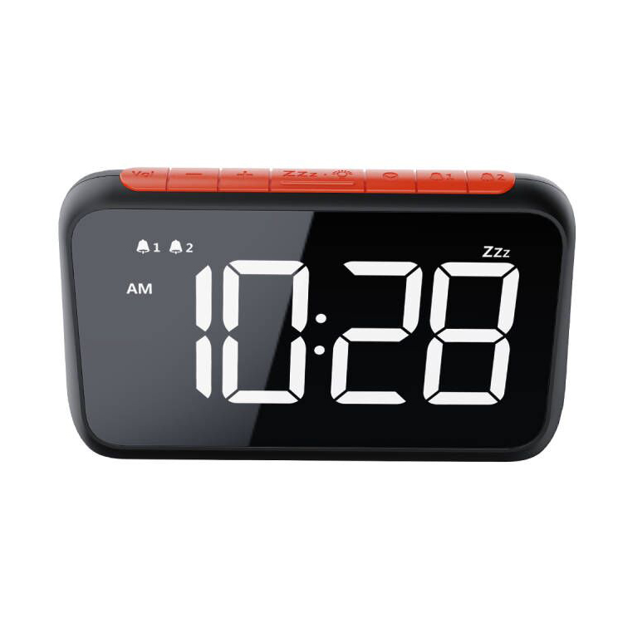
YGH-5277 Alarm Clock
2022 Newest
Product features:
Brightness adjustable: 6 speed brightness adjustment
Time function: 12/24 hour system conversion
Alarm function: Set two alarm clocks
Volume of noise: 2 sets of noise
Snooze function: 9 minutes later the alarm again
Specification：
Product size：160*96*41mm
Product weight：175.2g
Q‘ty:3000pcs
FOBSZ Price: USD9.2/PC

Slide 11
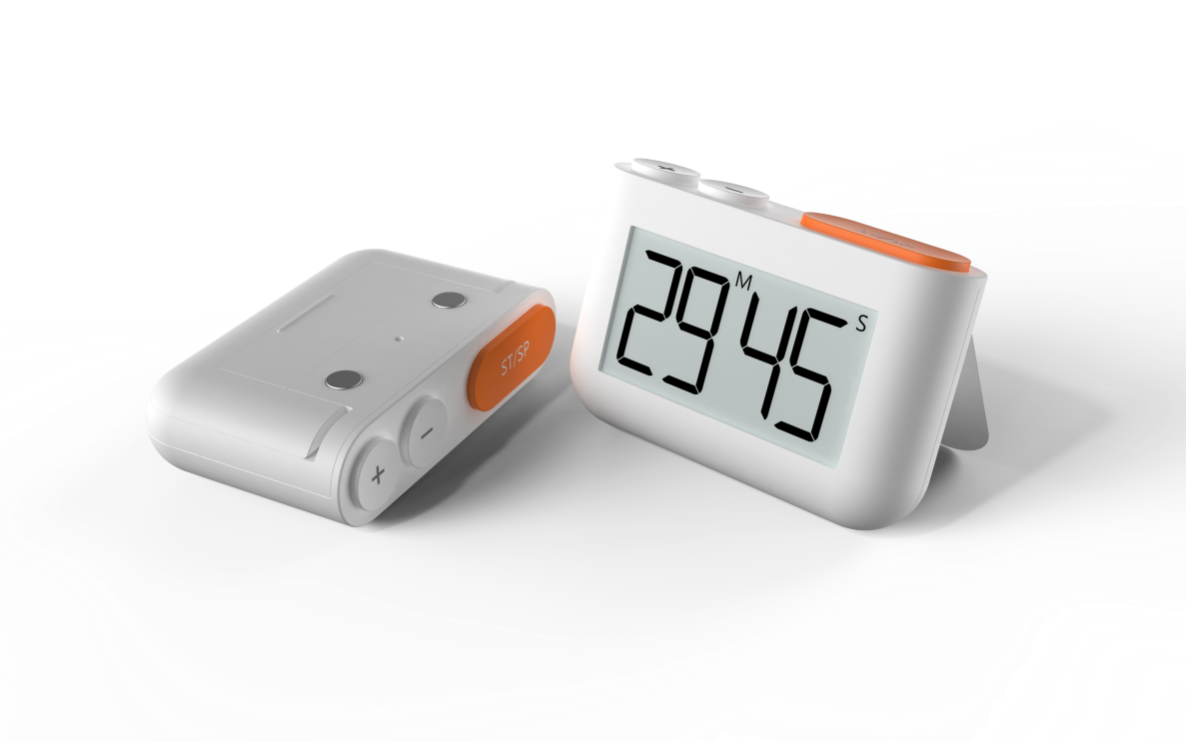
YGH-5273 Timer
Features:
4-digit clock function: hour, minute, default 12-hour format,
12H and 24H format can be converted
Timing function: Count up/Down Timer,Count range:0~99’59’’
Buzzer alarm, OPTION selects the sound frequency 2KHz or 4KHz
With key tone function
Toggle switch: choose between loud and low noise
Timer memory recall function;
Specification:
Power supply:2 *AAA (3V)
Working temperature: 0℃---50℃
Quiescent current: <30uA
Product size:85.5*55*24mm
Material:ABS
Product weight :57g
Packaging Info:
Carton size : 35*29*34.5CM
G.W: 12.1 KG
N.W: 11.3 KG
Q’TY: 150pcs
2021 Newest
Q‘ty:3000pcs
FOBSZ Price: USD2.4/PC

Slide 12
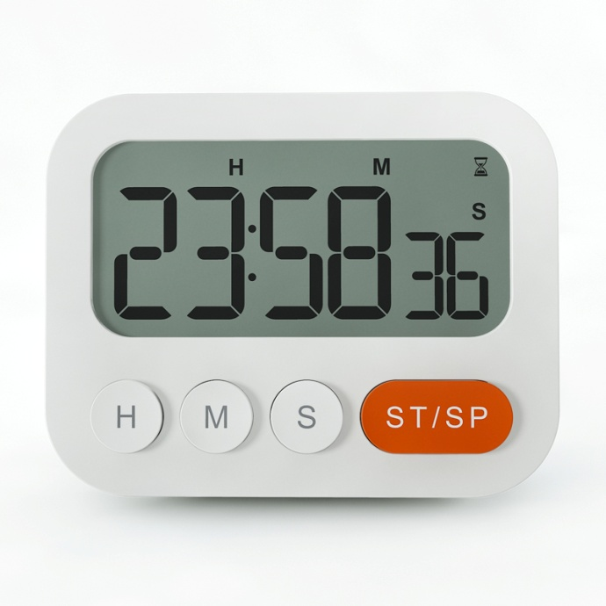
YGH-5270 Clock&Timer
Features:
4-digit clock function: hour, minute, default 12-hour format,
12H and 24H format can be converted
Timing function: Count up/Down Timer,Count range:0~99’59’’
Buzzer alarm, OPTION selects the sound frequency 2KHz or 4KHz
With key tone function
Volume:3-levels Alarm Volume
Timer memory recall function;
Specification:
Power supply:2 *AAA (3V)
Working temperature: 0℃---50℃
Quiescent current: <20uA
Product size:90*71*23mm
Material:ABS
Product net weight: 73.5g ( exclude battery)
Packaging Info:
Carton size :51.5*40*18.5 cm
G.W: 10.9 KG
N.W: 10.1KG
Q’TY: 100pcs
2021 Newest
Q‘ty:3000pcs
FOBSZ Price: USD4.0/PC

Slide 13
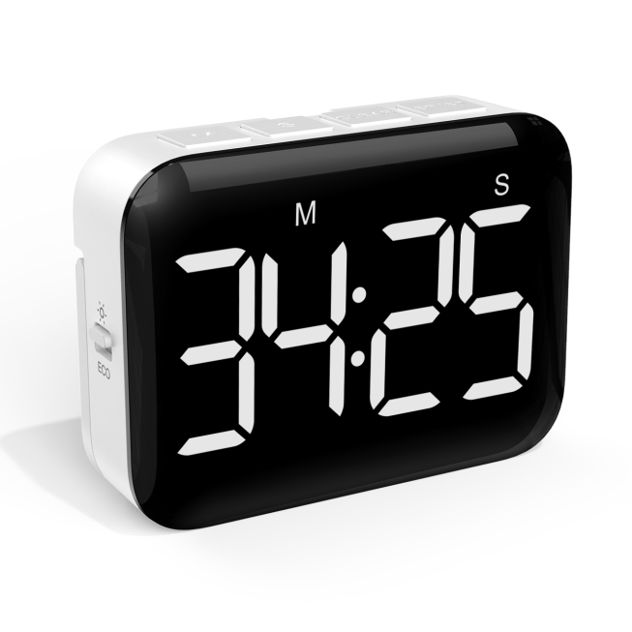
YGH-5268 Timer
2021 Newest
Features:
Large LED display;
3 volumes selection:High--low-Mute;
2 bightness mode(constant bright mode /ECO mode );
Timing function: Count up/Down Timer,Count range:0~99’59’;
Timer memory recall function;
Specification:
Power supply:3 *AAA (4.5V)
Product size:89*27*66mm
Material:ABS
Packaging Info:
Carton size : 42*24*40 cm
G.W: 10.8KG
N.W: 10.1KG
Q’TY: 100pcs
Amazon exclusive
Q‘ty:3000pcs
FOBSZ Price: USD5.6/PC

Slide 14
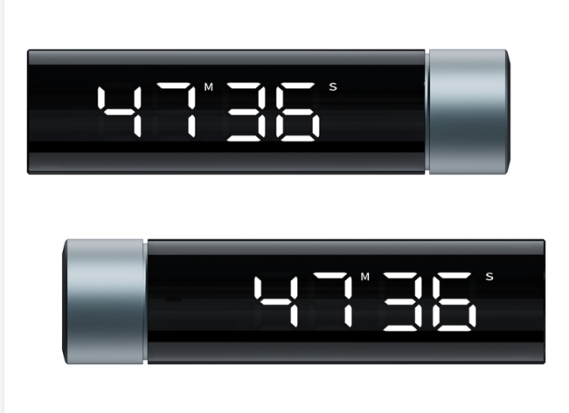
YGH-5263 LED rotary digital timer
2021 Newest
Features:
Large LED display;
Timer memory recall function;
ECO function(Auto sleep function);
Timing function: Count up/Down Timer,Count range:0~99’55’;
Specification:
Power supply:1*AAA (1.5V)
Product size:111*29mm
Material:ABS
Packaging Info:
Carton size : 45*23.5*26.5 cm
G.W: 11.3KG
N.W: 10.7KG
Q’TY: 100pcs
Q‘ty:3000pcs
FOBSZ Price: USD6.3/PC

Slide 15
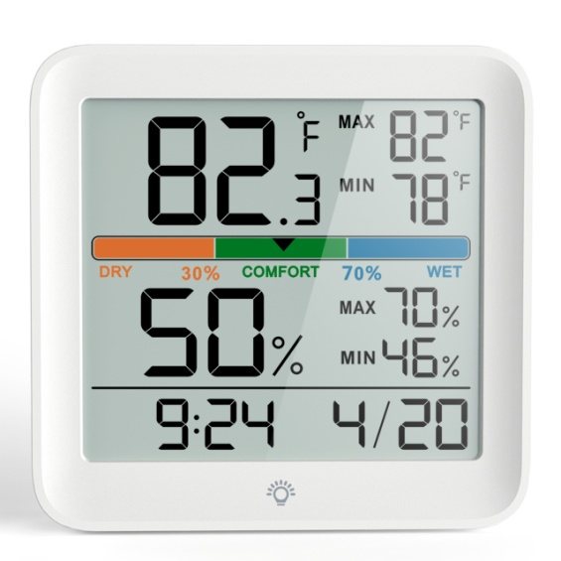
YGH-5275 Indoor Hygrothermograph
Features :
Indoor Temperature and humidity measurement
MAX/MIN temperature and humidity memory
Dry/Wet/Comfortable icon display
Time display ,Date display
12/24H format selection;C/F selectable
With backlight
Specification:
Power supply: 2pcs*AAA battery (exclude)
Temperature measuring range: -9.9℃~ 60℃（14.18˚F~140˚F）
Humidity measuring range: 0%~99%
Temperature accuracy: 0.1℃
Humidity measurement error: ± 5%RH
Humidity accuracy: 1%
Data update cycle: 10 seconds
Package information :
Carton size : 42*38*21cm
GW: 11.1KG NW:10.4KG
Qty:80pcs
2022 Newest
Amazon exclusive
Q‘ty:3000pcs
FOBSZ Price: USD6.3/PC

Slide 16
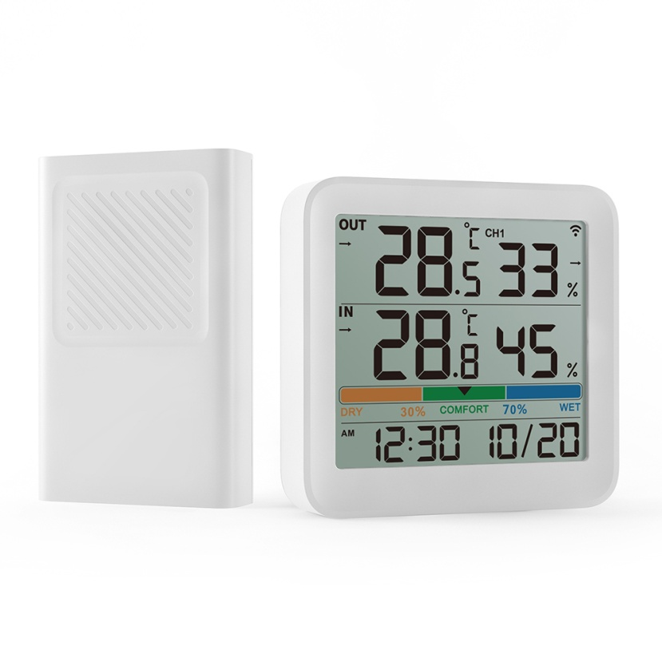
YGH-5276 Indoor Outdoor Hygrothermograph
Features :
Indoor Outdoor Temperature and humidity measurement
Dry/Wet/Comfortable icon display
Time display ,Date display
12/24H format selection;C/F selectable
Indoor outdoor temperature humidity trend function
Specification:
Power supply: 2pcs*AAA battery (exclude)
Indoor temperature measuring range: -10℃~ 60℃（14˚F~140˚F）
Outdoor temperature measuring range: -50℃~ 70℃（-58˚F~158˚F）
Indoor Outdoor Humidity measuring range: 20%~95%
Temperature Resolution:0.1 ℃
Humidity measurement error: ± 5%RH
Humidity Resolution: 1%
Data update cycle: 10 seconds
2022 Newest
Amazon exclusive
Q‘ty:3000pcs
FOBSZ Price: USD11/PC

Slide 17
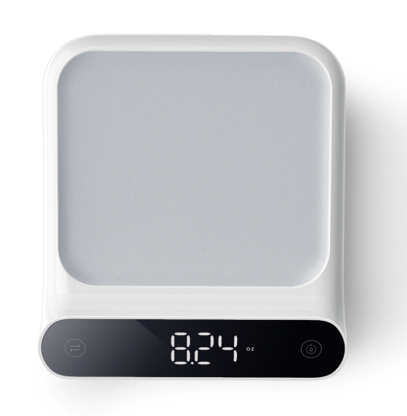
YGH 5262 Kitchen digital scale
Features:
Large LED display;
Weight value lock function;
Peeling function;
Low battery reminder(It will turn off after display “Lo” 2seconds)
Overwght display:EEEEE
ECO function(it will power off if no any operation within 120 seconds)
Touch button ,easy to operate;
Specification:
Product size:mm
Material:ABS+PC
Power supply:3 AAA batteries(4.5V)
Color:millet white+Pantone 6C gray /can be customized
Packaging Info:
N.W: Carton size (CM)58.5*31*35.5
Packing Quantity (PCS)30 Gross weight (KG)11.5
Net weight (KG)10.8
2021 Newest
Q‘ty:3000pcs
FOBSZ Price: USD6.8/PC

Slide 18
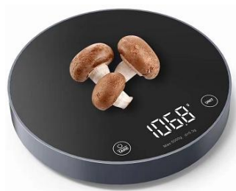
YGH 5286 Kitchen digital scale
Features:
Large LED display;
Weight value lock function;
Peeling function;
Low battery reminder(It will turn off after display “Lo” 2seconds)
Overwght display:EEEEE
ECO function(it will power off if no any operation within 120 seconds)
Touch button ,easy to operate;
Specification:
Product size:mm
Material:ABS+Tempered
Power supply:3 AAA batteries(4.5V)
Packaging Info:
N.W: Carton size (CM)58.5*31*35.5
Packing Quantity (PCS)30 Gross weight (KG)11.5
Net weight (KG)10.8
2022 Newest
Amazon exclusive
Q‘ty:3000pcs
FOBSZ Price: USD8/PC

Slide 19
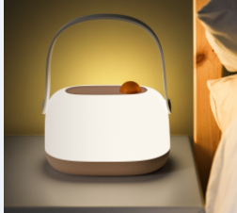
2022 Newest
K680 Night light
Features:
Portable design, convenient for users to carry the mobile lamp body, or can be hung in a suitable place;
Polarless dimming, according to consumers like, adjust the different brightness;
Simple operation, short press the light on and off, rotating brightness;
Built-in battery, can get rid of the constraints of the wire, suitable for more different use scenarios
Specification:
Power supply: built-in lithium battery, Battery capacity: 1800mAh
LED light color temperature 3000K, warm white
Working hours:At its brightest, it works for about five hours,It can work for about 50 hours in the darkest state
Product size:143*90*87.5mm Product weight :205g
Package size:156*96*120 Package weight: 303g
Packaging Info:
Carton size: 45.6*38.7*36.5cm
Q’TY：40PCS
G.W.：12.5KG
N.W.：11.2KG
Q‘ty:3000pcs
FOBSZ Price: USD7/PC

Slide 20
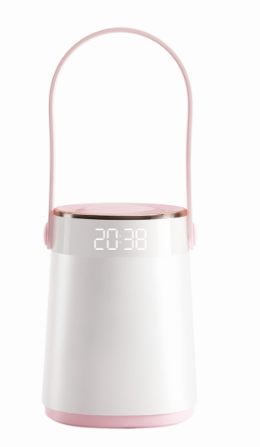
2022 Newest
K681 Night light With Time and temperature
Features:
Portable design, convenient for users to carry the mobile lamp body, or can be hung in a suitable place;
Polarless dimming, according to consumers like, adjust the different brightness;
Simple operation, short press the light on and off, rotating brightness;
Built-in battery, can get rid of the constraints of the wire, suitable for more different use scenarios
With time display and alarm snooze function. In 12/24 hours format
With tempeature display in C/F format
Specification:
Power supply: built-in lithium battery, Battery capacity: 1800mAh
LED light color temperature 3000K, warm white
Working hours:At its brightest, it works for about five hours,It can work for about 50 hours in the darkest state
Product size:143*90*87.5mm Product weight :205g
Package size:156*96*120 Package weight: 303g
Packaging Info:
Carton size: 57*51.5*35.5c cm
Q’TY：32PCS
G.W.：KG
N.W.：KG
Q‘ty:3000pcs
FOBSZ Price: USD8.8/PC

Slide 21
Nightlight series
2

Slide 22
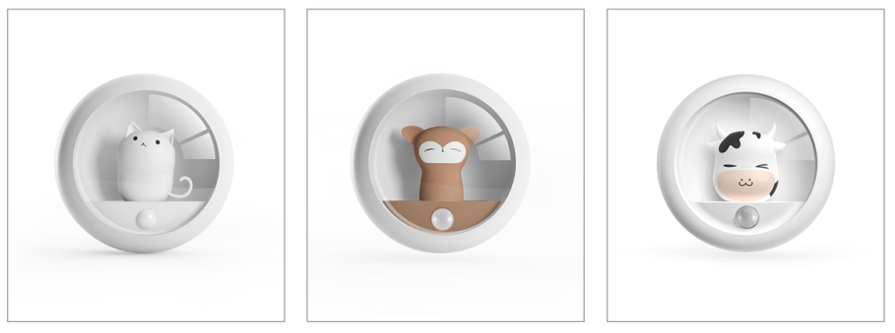
K610 Motion nightlight
Features:
Dual sensing mode: photosensitive + dual human body sensors
Two lighting modes: constant light + induction, two brightness levels: high light + low light
LED light color temperature 4000K, natural white
Working hours: strong light is always on, about 20 hours of work,
It can work for about 300 hours in low-light mode.
Automatic transmission (highlighting 10 times a day): about 24 days of work;
Specification:
Input: DC 5V 0.4A
Charging Time: 2H
Battery Capacity: 600mAh
Product size:79*33mm
Material:ABS
Product weight :70g
Packaging Info:
Carton size: 45.6*38.7*36.5
G.W: 8.5 KG
N.W: 9.6KG
Q’TY: 100 PCS
Q‘ty:3000pcs
FOBSZ Price: USD4.8/PC

Slide 23
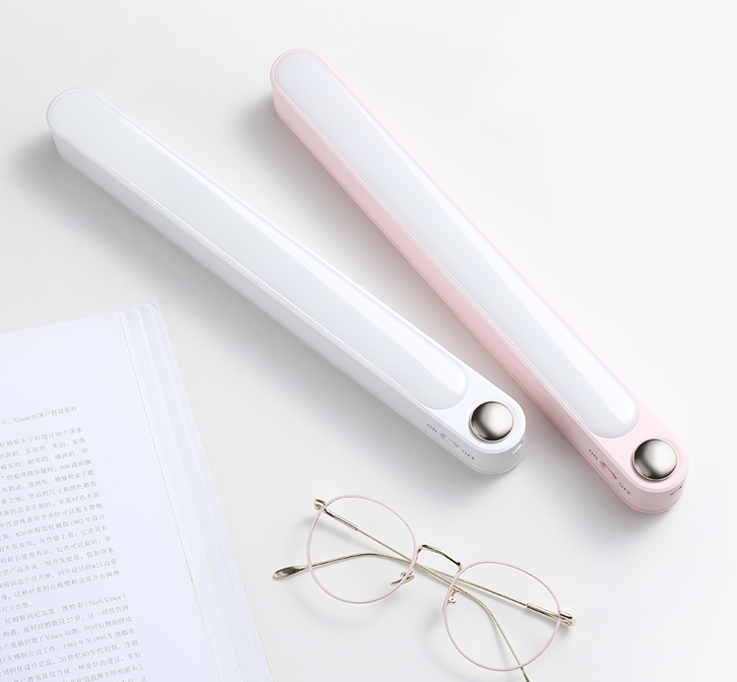
K620 Strip wall light
Features:
Brightness adjustment: stepless dimming
LED lamp color temperature 4000K, natural white
Working time: the strong light is always on for about 3 hours,
The low light is always on and can work for about 30 hours
Two fixation methods: suspension and magnetic suction
Regular colors: white, pink (customizable color)
Specification:
Charging Time: 4H
Battery Capacity: 1200mAh
Product size:297*32*33mm
Material:ABS
Product weight :157g
Packaging Info:
Carton size: 39*27*32cm
G.W: 11.8 KG
N.W: 11.2KG
Q’TY: 50 PCS
Q‘ty:3000pcs
FOBSZ Price: USD4.8/PC

Slide 24
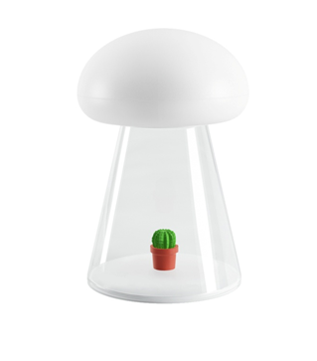
K630 Music nightlight
Features:
Brightness adjustment: stepless dimming
LED lamp color temperature 4000K, natural white
Brightness adjustment:High-Low-colorful nightlight
Working time: the strong light is always on for about 6 hours,
The low light is always on and can work for about 60 hours
Regular colors: white, pink (customizable color)
Specification:
Charging Time: 4H
Battery Capacity: 1200mAh
Product size:98*98*152mm
Material:ABS
Product weight :173g
Packaging Info:
Carton size: 52x52x33.5CM
G.W: 13KG
N.W: 12.4KG
Q’TY: 50PCS
Q‘ty:3000pcs
FOBSZ Price: USD4.8/PC

Slide 25
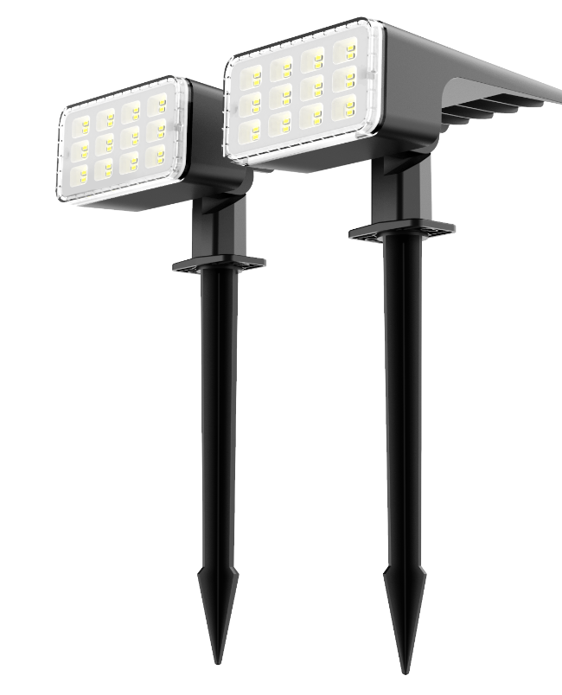
K640 Lawn lamp
Features:
IP67 waterproof
High-efficiency solar panels convert solar energy into electricity
Can be used for outdoor lawn lighting, can also be fixed on the wall, used as a wall lamp, is also a good choice for outdoor camping
built-in lithum battery
Specification:
Battery Capacity: mAh
Product size:mm
Material:ABS
Product weight :g
Packaging Info:
Carton size: 58.5*37*39.5cm
G.W: 12.9KG
N.W:12.2 KG
Q’TY: 20PCS
Amazon exclusive
Q‘ty:3000pcs
FOBSZ Price: USD5.6/PC

Slide 26
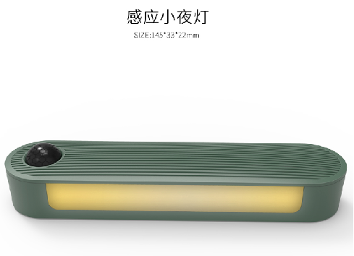
K611 Motion nightlight
Product features:
Night light mode: three modes are available (steady on/off/Automatic).
Night light intensity: the night light has two brightness options (low light/high light).
Night-light sensing range: it is the 120-degree sector area of the night-light sensor center, with a distance of about 3 meters.
Charging time: 2-2.5 hours
Service time: HIGH HIGH bright long bright: discharge time: 3.5-4 hours, LOW LOW bright long bright: discharge time: 50 hours.
Products with magnetic suction
During the charging process, the red light is long on, and when fully charged: the red light is off.
The charging port is type C port.
Measurements:
Product size: 137*31*29MM
Product naked weight: 61g
2022年新品
Amazon exclusive
Q‘ty:3000pcs
FOBSZ Price: USD4.8/PC

Slide 27
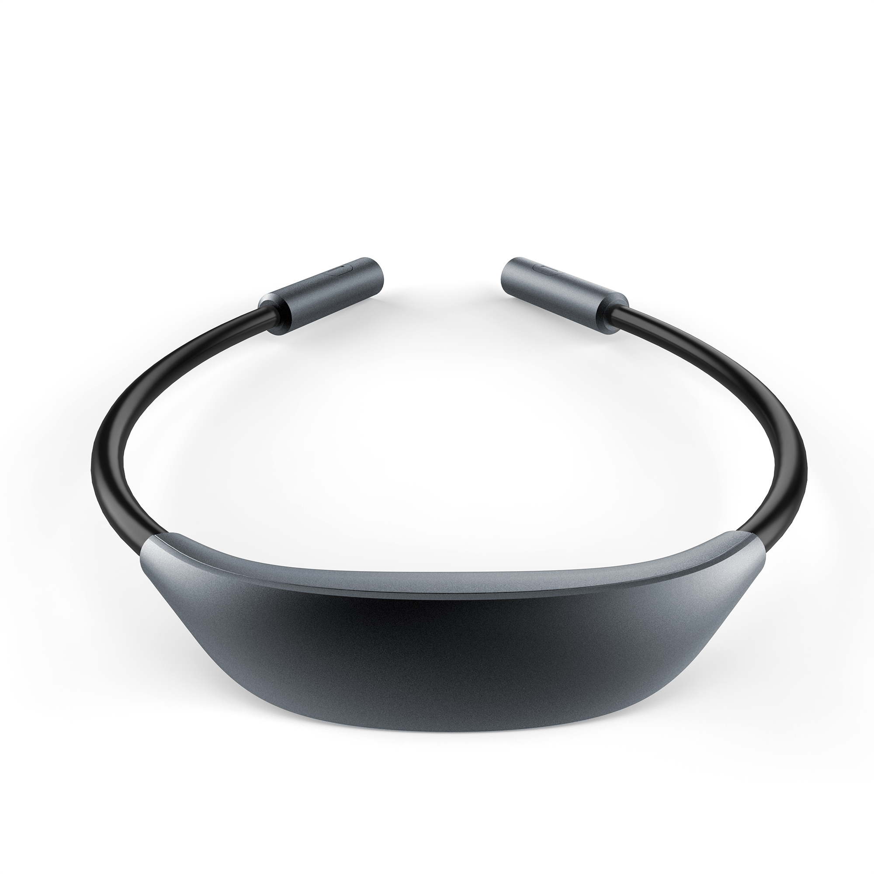
K621 Neck hung lamp
Product color: black
Material: ABS+ acrylic + silica gel
Battery capacity: 1000 mah
Rated voltage: DC5V
Maximum power: 3.5W
Product features:
Power supply: built-in lithium battery
Light mode: Stepless dimming
Light mode: three levels of brightness, LED light color temperature 3000K/4000K/5000K
Regular color: silver grey/black
Product Attributes:
Net weight: 154G
Host size: 710*34*21 (mm)
Color box size: 164*44*153 (mm)
Number of boxes: 1pcs
Packing quantity: 60pcs
2021年新品
Amazon exclusive
Q‘ty:3000pcs
FOBSZ Price: USD7.1/PC

Slide 28
Timer series
3

Slide 29
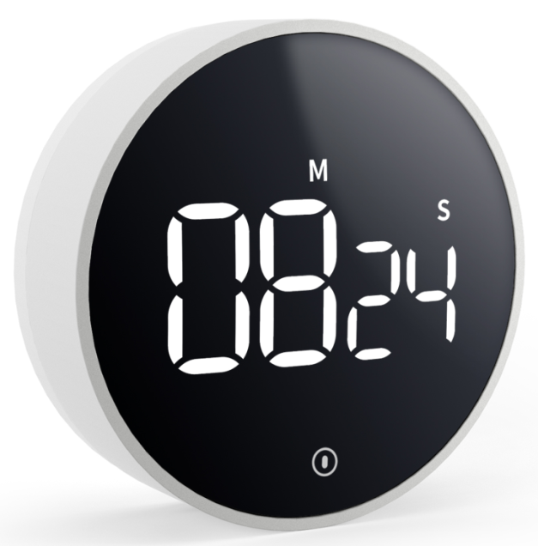
YGH-5260 LED Rotary timer
Features:
Large LED display, counts down and up, timing range:99’55’’
Timer memory recall function
Volume adjustment:High-Low-Mute
2 bightness mode(constant bright mode /ECO mode );
Powered by 3PCS AAA battery (not included)
color: white
Specification:
Product size: 78.3*78.3*28mm
Material: Plastic (ABS)
product weight: 71.6g
Packaging Info:
Carton size: 42*19.5*35CM
G.W: 10.7 KG
N.W: 10KG
Q’TY: 100 PCS
Amazon exclusive
Q‘ty:3000pcs
FOBSZ Price: USD4.8/PC

Slide 30
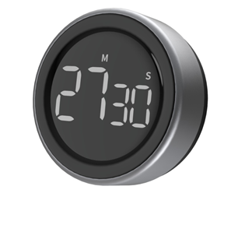
YGH-5250 LED rotary timer
Features:
Large LED display, counts down and up, timing range:99’55’’
Timer memory recall function
Volume adjustment:High-Low-Mute
2 bightness mode(constant bright mode /ECO mode );
Powered by 3PCS AAA battery (not included)
color: white
Specification:
Product size: 78*27.5mm
Material: Aluminum
product weight: 89g
Packaging Info:
Carton size: 42*19.5*35CM
G.W: 12 KG
N.W: 11.4KG
Q’TY: 100 PCS
Amazon exclusive
Q‘ty:3000pcs
FOBSZ Price: USD6.3/PC

Slide 31
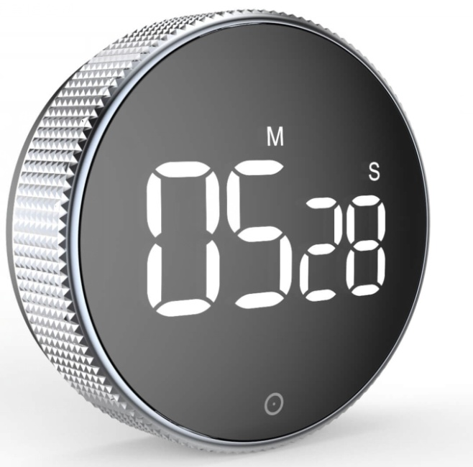
YGH-5237 LED Rotary timer
Features:
Large LED display, counts down and up, timing range:99’55’’
Timer memory recall function
Volume adjustment:High-Low-Mute
Powered by 3PCS AAA battery (not included)
color: white
Specification:
Product size: 78*27.5mm
Material: Plastic (ABS)
product weight: 76g
Packaging Info:
Carton size: 42*19.5*35CM
G.W: 11KG
N.W: 10KG
Q’TY: 100 PCS Amazon exclusive
Q‘ty:3000pcs
FOBSZ Price: USD5.0/PC

Slide 32
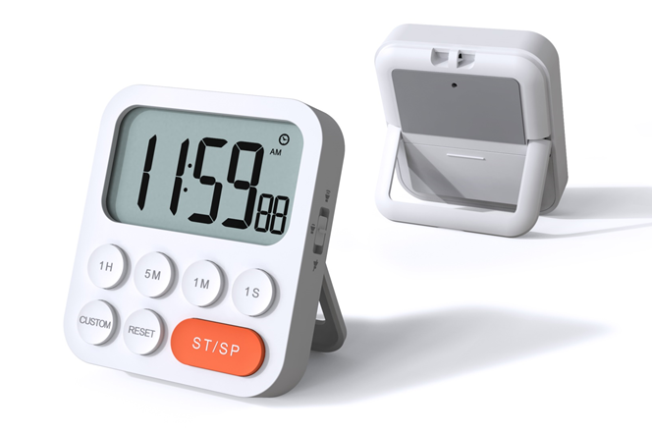
YGH-5249 Timer
Features:
Large LCD display, counts down and up, timing range:99h59m59s
Clock function ;12/24 hour format selection
Timer memory recall function
Volume adjustment:High-Low-Mute
Powered by 2PCS AAA battery (not included)
color: white
Specification:
Product size: 81*89*24mm
Material: ABS
product weight: 83g
Packaging Info:
Carton size: 47.5*31*20CM
G.W: 13.2KG
N.W: 12.4KG
Q’TY: 100 PCS
Amazon exclusive
Q‘ty:3000pcs
FOBSZ Price: USD5.0/PC

Slide 33
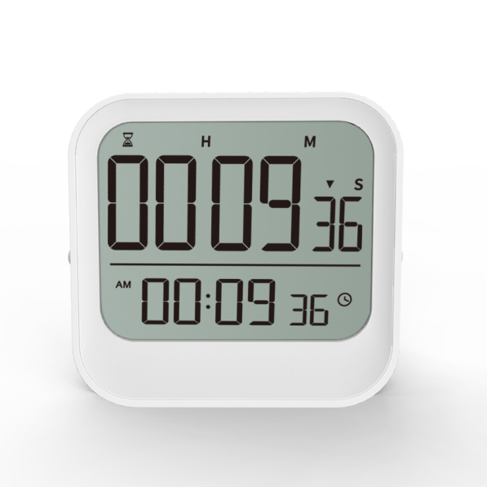
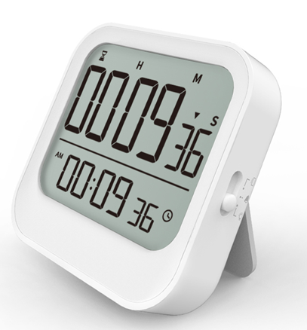
YGH 5246 clock&timer
Features:
3 groups of alarms, snooze function, timer function
Automatic cycle countdown function
12/24 hour format can be switched
ECO power-saving function
Time by Pomodoro Technique
Volume adjustment: mute/vibration/ alarm
Timer memory recall function
Powered by 2PCS AAA battery (not included)
color: white
Specification:
Product size: 83*80*23mm
Material: ABS
product weight: 97g
Packaging Info:
Carton size: 44*31.5*18.5CM
G.W: 11.8KG
N.W: 11.2KG
Q’TY: 100 PCS
Q‘ty:3000pcs
FOBSZ Price: USD5.6/PC

Slide 34
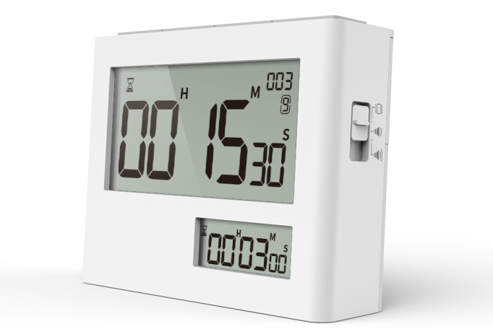
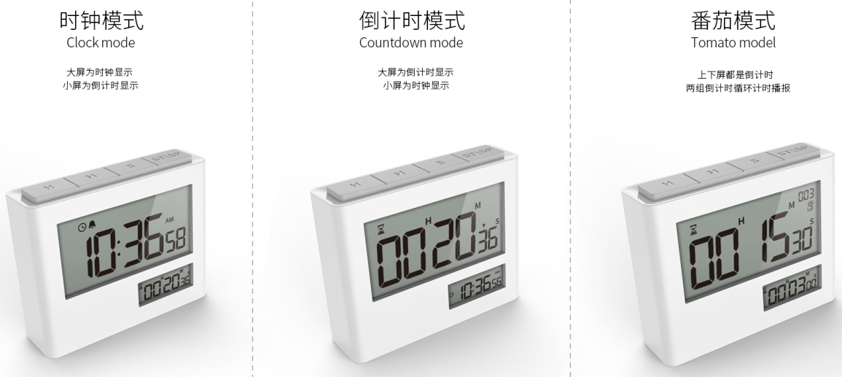
YGH-5239 Pomodoro timer&clock
Features:
alarm function, timer function
Automatic cycle countdown function
12/24 hour format can be switched
ECO power-saving function
Time by Pomodoro Technique
Volume adjustment: mute/vibration/ alarm
Timer memory recall function
Powered by 2PCS AAA battery (not included)
color: white
Specification:
Product size: 93*73*26.5mm
Material: ABS
Packaging Info:
Carton size: 31*22*40CM
G.W: 12.1KG
N.W: 11KG
Q’TY: 100 PCS
Q‘ty:3000pcs
FOBSZ Price: USD4.8/PC

Slide 35
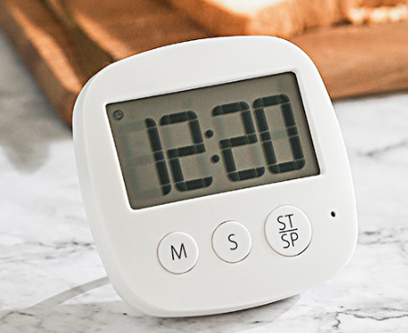
YGH-127A Timer&Clock
Features:
Large LCD digital display;Clock function
Counts down and up;Timing range: 99 minutes 59 seconds
Timer memory recall function;Volume adjustment
Retractable stand;Three magnets and hook at the back for versatile use
Specification:
Display: LCD screen
Battery: 1*AAA(not included)
Alarm volume: ≥75DB
Product size: 84*84*23mm
Packaging Info:
QTY: 150PCS
MEAS: 45*30*28CM
N.W: 12.7KG
G.W: 12KG
Q‘ty:3000pcs
FOBSZ Price: USD2.5/PC

Slide 36
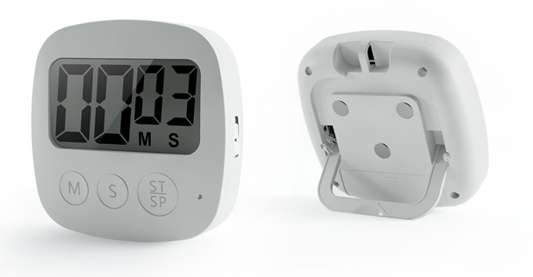
YGH-127B Timer
Features:
Large LCD digital display;
Counts down and up;Timing range: 99 minutes 59 seconds
Timer memory recall function;Volume adjustment
Retractable stand;Three magnets and hook at the back for versatile use
1 minute off screen function without operation
Specification:
Display: LCD screen
Battery: 1*AAA(not included)
Alarm volume: ≥75DB
Product size: 84*84*23mm
Packaging Info:
QTY: 150PCS
MEAS: 45*30*28CM
N.W: 12.7KG
G.W: 12KG
Q‘ty:3000pcs
FOBSZ Price: USD2.5/PC

Slide 37
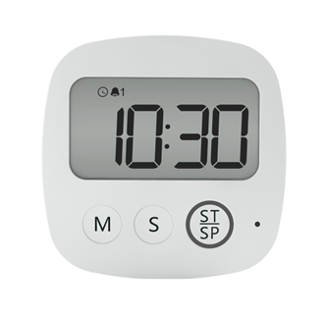
YGH-127D Timer
Features:
Large LCD digital display;Clock function
Dual alarm function ;
Counts down and up;Timing range: 199 minutes 59 seconds
Timer memory recall function;Volume adjustment
Retractable stand;Three magnets and hook at the back for versatile use
Specification:
Display: LCD screen
Battery: 1*AAA(not included)
Alarm volume: ≥75DB
Product size: 84*84*23mm
Packaging Info:
QTY: 150PCS
MEAS: 45*30*28CM
N.W: 12.7KG
G.W: 12KG
Q‘ty:3000pcs
FOBSZ Price: USD3.2/PC

Slide 38
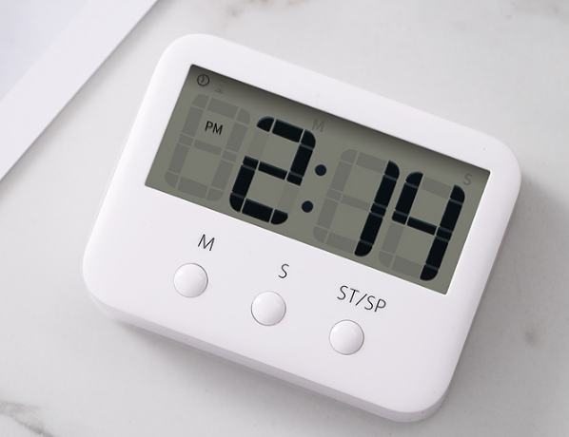
YGH-118s Timer
Features:
Large LCD digital display;Clock function
Counts down and up;Timing range: 99 minutes 59 seconds
Timer memory recall function;
Retractable stand;Three magnets and hook at the back for versatile use
Specification:
Display: LCD screen
Battery: 1*AAA(not included)
Alarm volume: ≥75DB
Product size: 80*61*20.7mm
Packaging Info:
QTY: 200PCS
MEAS: 43.5*26.5*29.5CM
N.W: 11.6KG
G.W: 11KG
Q‘ty:3000pcs
FOBSZ Price: USD3.2/PC

Slide 39
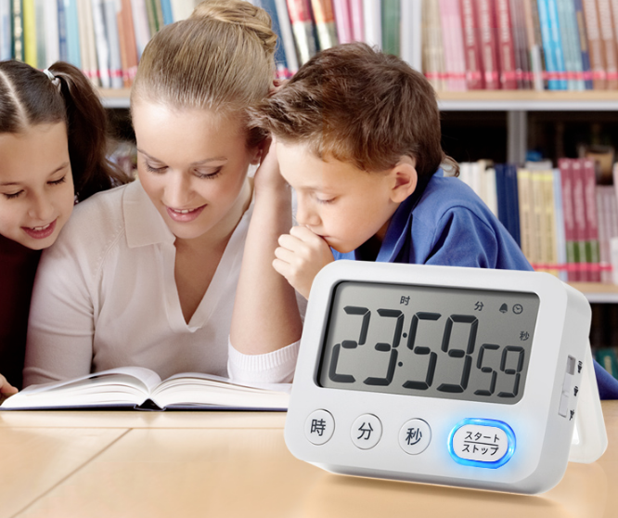
YGH-118P Clock & Timer
Features:
Large LCD digital display;Clock function
Silent flash mode
Counts down and up;Timing range: 99 minutes 59 seconds
Timer memory recall function;
Retractable stand;Three magnets and hook at the back for versatile use
Specification:
Display: LCD screen
Battery: 1*AAA(not included)
Alarm volume: ≥75DB
Product size: 90*65*23.9mm
Packaging Info:
QTY: 150PCS
MEAS: 48*31*23CM
N.W: 11.8KG
G.W: 11K
Q‘ty:3000pcs
FOBSZ Price: USD3.2/PC

Slide 40
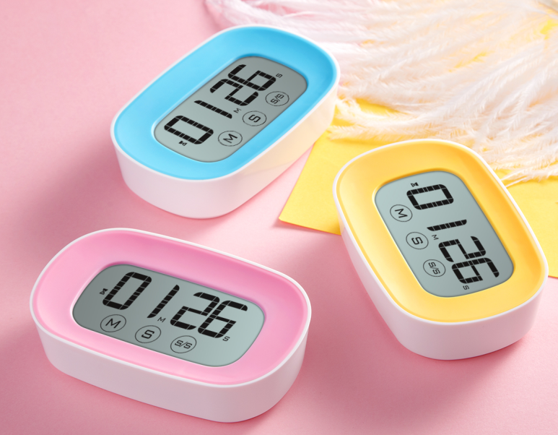
YGH-125S Timer & Clock
Features:
Large LCD digital display;Clock function
Counts down and up;Timing range: 99 minutes 59 seconds
Timer memory recall function;
Retractable stand;Three magnets and hook at the back for versatile use
Specification:
Display: LCD screen
Battery: 2*AAA(not included)
Alarm volume: ≥75DB
Product size: 102*62*25mm
Packaging Info:
QTY: 120PCS
MEAS: 44.3*31.5*22.5CM
N.W: 12KG
G.W: 11.4KG
Q‘ty:3000pcs
FOBSZ Price: USD3.2/PC

Slide 41
Clock series
4

Slide 42
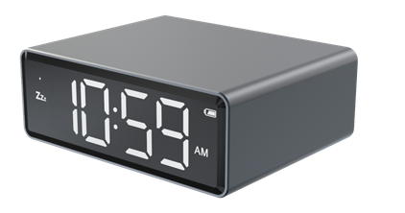
YGH 5245Portable digital clock
Features:
Large LED display
Time diaply;12/24 format selection
2 group alarm ;Snooze function
4 levels brightness adjustment
Two kinds supply powered :one is powered by batteries ;one is powered by adapter
Specification:
Product size: 83*69*30mm
Material: Aluminum
product weight: 118g
Packaging Info:
Color box size:mm
Carton size: 41*20*28.5CM
G.W: 9.7 KG
N.W: 8.8KG
Q’TY: 60PCS
Amazon exclusive
Q‘ty:3000pcs
FOBSZ Price: USD7.1/PC

Slide 43
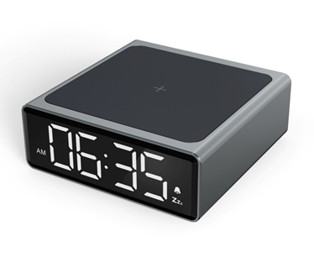
YGH 5244 10W wireless charger clock
Features:
Large LED display
Time diaply;12/24 format selection
2 group alarm ;Snooze function
4 levels brightness adjustment
10W fast wireless charger function
Specification:
Product size: 83*69*30mm
Material: Aluminum
product weight: 118g
Packaging Info:
Color box size:mm
Carton size: 41*20*28.5CM
G.W: 9.7 KG
N.W: 8.8KG
Q’TY: 60PCS
Amazon exclusive
Q‘ty:3000pcs
FOBSZ Price: USD11.0/PC

Slide 44
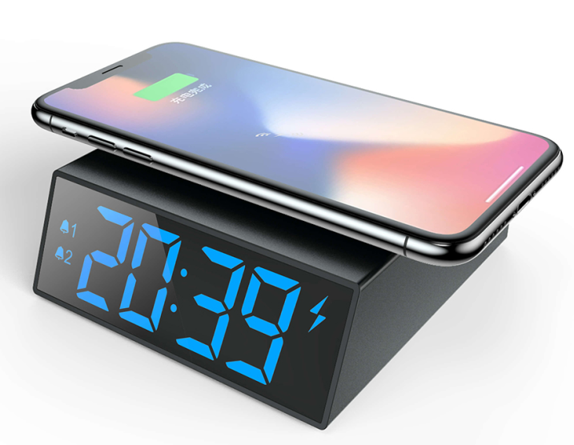
YGH 5231 10W wireless charger clock
Features:
Large LED display
Dual alarm clock with snooze function
12/24 Hours format
4 level brightness control
10W Wireless charging function
Specification:
Wireless charging 10W(support fast charging phone)
Power supply : QC3.0 adaptor (not included)
TYPE-C Input : Depend on the adapter
Size : 100*106*35mm,weight:162g
Packaging Info:
Colorbox size:132*52*108mm
Weight:235g including the color box
QTY:60pcs
MEAS: 41.5*28*45.5CM
N.W: 14.5KG
G.W: 15.5KG
Q‘ty:3000pcs
FOBSZ Price: USD8.7/PC

Slide 45
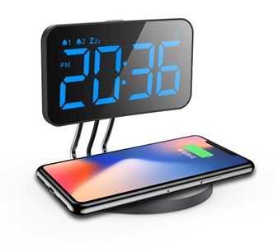
YGH 3170 10W wireless charger clock
Features:
Double Alarm function
Snooze function
6 levels of brightness can be adjusted
12/24 hour format selection
Specification:
Size:mm
Weight:437g
Packaging Info:
Colorbox size:mm
Weight: 450g including the color box
Carton size : 59.5*58*30.5 cm
G.W: 14.8KG
N.W: 14KG
Q’TY: 32PCS
Q‘ty:3000pcs
FOBSZ Price: USD12.3/PC

Slide 46
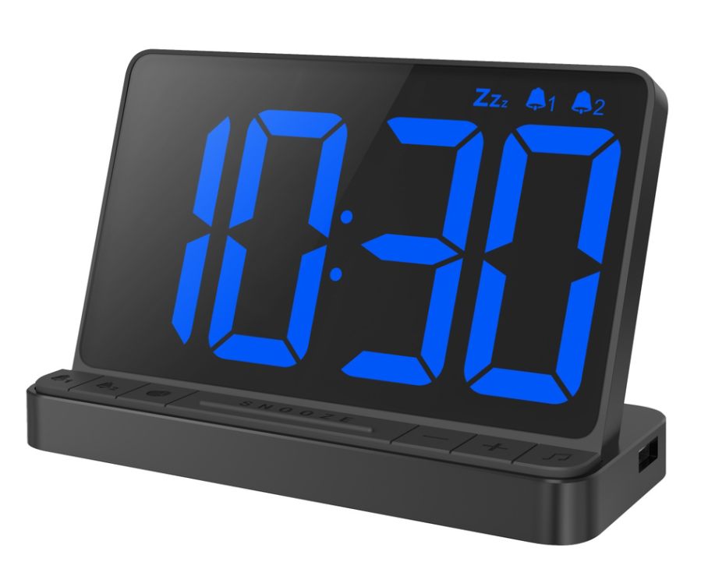
YGH 5256 70 degree alarm clock
Features:
Clock function, 12/24 hour format optional;
Alarm clock function, can set 2 groups of alarm ;
3 levels of volume adjustable;
5 groups of alarm sounds are optional (chord sound (01), bird chirping (02), ocean wave sound (03), music box (04), BIBI (bu) sound);
Snooze function;
LED screen brightness stepless dimming;
USB output charging function (charging voltage: 5V, charging current: 0.8A (MAX));
Specification:
Product size: 152.5*62.3*96.1mm
Material: Plastic (ABS)
product weight: 179.2g
Packaging Info:
Carton size: 43.5*38*34.5CM
G.W: 13.1KG
N.W: 12.6KG
Q’TY: 100 PCS
QTY :2000 pcs
FOB price: USD11.1/PC

Slide 47
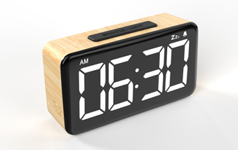
YGH-5252 LED clock
Features :
Clock function
1 group alarm function
Snooze function
Six level brightness control
12/24H format selection
Specification:
size: :140*77*41.5 mm
Product weight: g
Material : ABS/PC
Battery type:1*3V CR2032 button battery (included)
Input Power: AC100-240V,50/60Hz
Package information :
Carton size :36.5*29.5*39.5cm
G.W: 10.5KG
N.W: 10 KG
Q’TY: 40PCS
QTY :3000 pcs
FOBSZ Price: USD8.5/PC

Slide 48
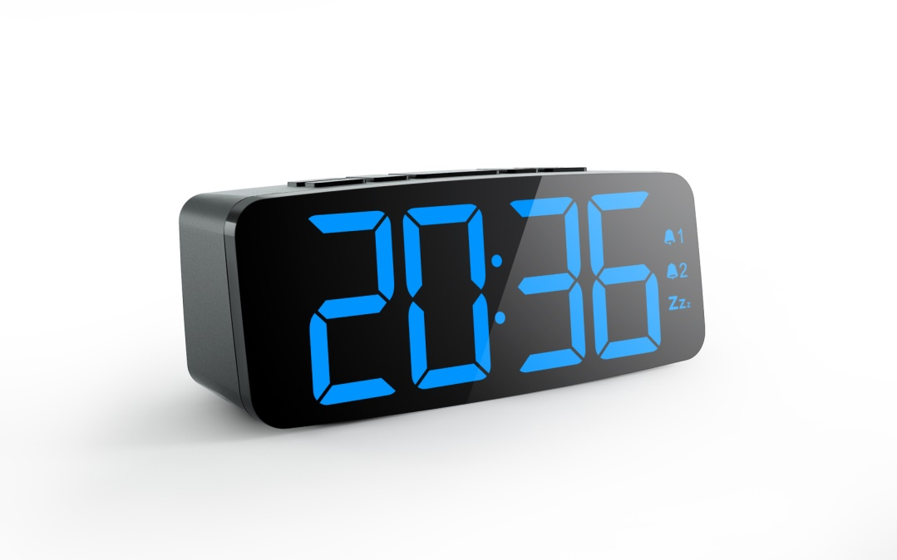
Features:
Clock function
Double Alarm function
Snooze function
Six level brightness control
Two alarm ringtones are available
12/24H format selection
Specification:
size: : 156*64*50cm
Product weight: 218g
Material : ABS/PC
Battery type:1*3V CR2032 button battery (included)
Packaging Info:
Carton size : 39.5*32*36cm
G.W: 12.46 KG
N.W: 11.6KG
Q’TY: 40PCS
YGH 5230 LED clock
Q‘ty:10,000pcs
FOBSZ Price: USD7.9/PC

Slide 49
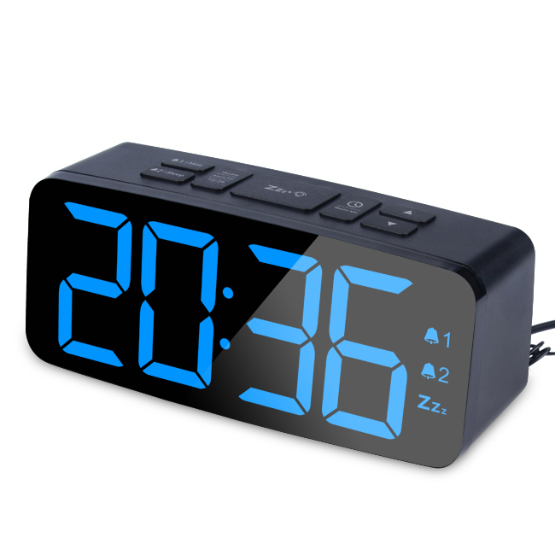
Features:
FM Radio function
Clock function
Double Alarm function
Snooze function
Six level brightness control
Two alarm ringtones are available
12/24H format selection
Specification:
size: : 156*64*50cm
Product weight: 218g
Material : ABS/PC
Battery type:1*3V CR2032 button battery (included)
Packaging Info:
Carton size : 39.5*32*36cm
G.W: 12.46 KG
N.W: 11.6KG
Q’TY: 40PCS
YGH 5230F Radio Clock
Q‘ty:10,000pcs
FOBSZ Price: USD7.9/PC

Slide 50
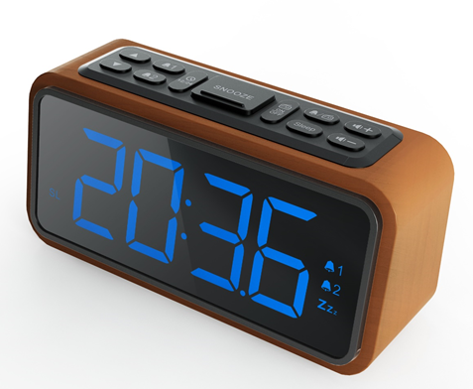
YGH 5240 Wooden radio clock
Features:
Large LED display
Really wooden material , elegant and high-end
FM radio with sleep function ,radio automatic search and save function
Dual alarms ,two alarm ringtones
Digital alarm clock with dimmer and snooze
Large display , the height of the digit is 2 inches
With USB charging port
Specification:
size: : 170*63.77*84.50 mm
Product weight: 276g
Material : Wood + plastic
Battery type:1*3V CR2032 button battery (included)
Packaging Info:
Carton size : 45*38.5*30 cm
G.W: 12.5KG
N.W: 11.6KG
Q’TY: 30PCS
Q‘ty: 3,000pcs
FOBSZ Price: USD13.5/PC

Slide 51
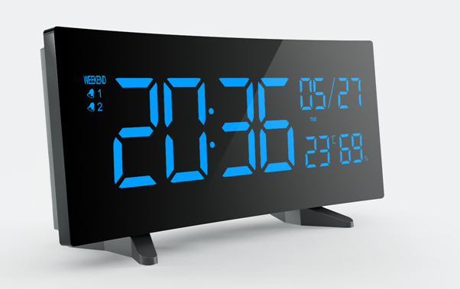
Features:
6.5inch curved-screen clock shows the time clearly
Indoor Temperature and Humidity Function
Double Alarm function
Weekend Mode,Snooze function
4 levels of brightness can be adjusted
With USB Charging port
Specification:
Size:179*92*56mm
Weight:305g
Adapter Input: AC100-240V, 50/60Hz
Adapter Output: 5.0V,1.5A
USB Charging: 5.0V,1.2A Max
Temperature Range: 0°C-50°C Humidity Range: 20%-95%
Packaging Info:
Carton size : 49.5*36*25 cm
G.W: 10.3KG
N.W: 9.6KG
Q’TY: 30PCS
YGH-3150 Large digital clock
Q‘ty: 3,000pcs
FOBSZ Price: USD12.7/PC

Slide 52
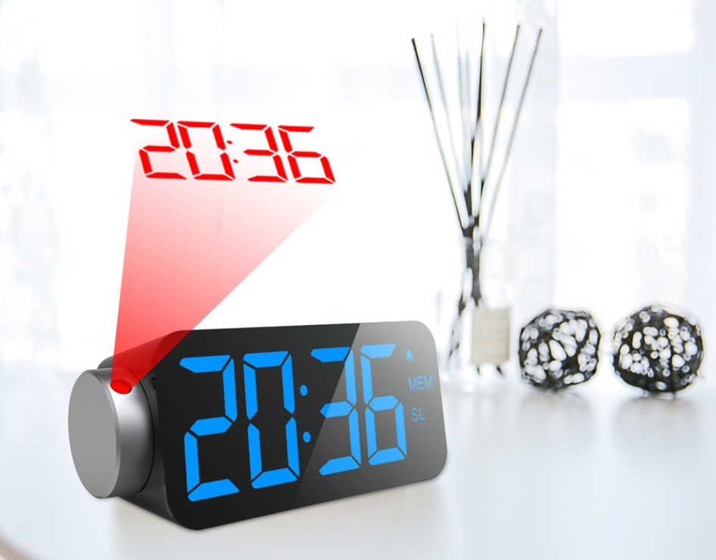
YGH 3710 Projection clock
Features:
Projection Time Function
FM Radio with Sleep Timer
Double Alarm function
USB Charging & Battery Backup,Snooze function
3 levels of brightness can be adjusted
With USB Charging port
Specification:
size: : 170*63.77*84.50 mm
Product weight: 276g
Material : Wood + plastic
Battery type:1*3V CR2032 button battery (included)
Power: Adaptor AC100-240V,50/60Hz 1.5A (included)
Packaging Info:
Carton size : 43.5*39.5*30 cm
G.W: 11.4KG
N.W: 10.7KG
Q’TY: 30PCS
Q‘ty: 3,000pcs
FOBSZ Price: USD12.7/PC

Slide 53
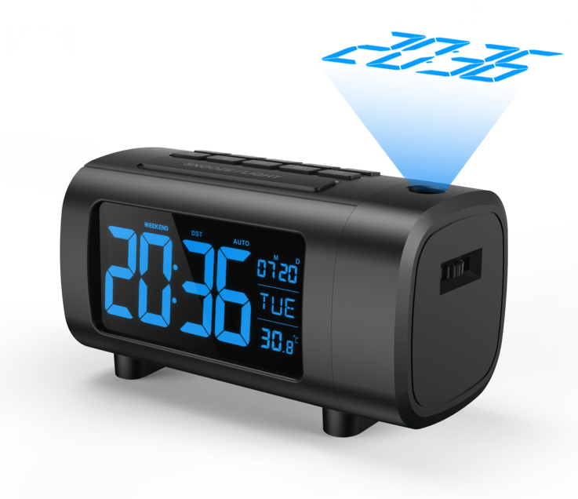
Features:
Projection Time Function
FM Radio with Sleep Timer
Double Alarm function
USB Charging & Battery Backup,Snooze function
4 levels of brightness can be adjusted
With USB Charging port
Specification:
size: :20*90*90 mm
Product weight: 358g
Material : plastic
Battery type:1*3V CR2032 button battery (included)
Power: Adaptor AC100-240V,50/60Hz 1.5A (included)
Packaging Info:
Carton size : 48.5*44*30 cm
G.W: 11.4KG
N.W: 10.7KG
Q’TY: 30PCS
YGH 3200 Projection clock
Amazon exclusive
Q‘ty: 3,000pcs
FOBSZ Price: USD12.7/PC

Slide 54
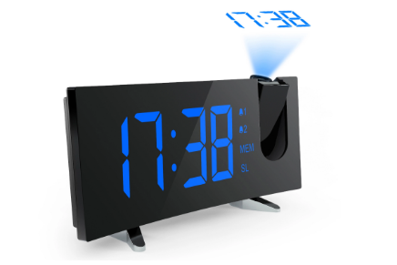
YGH 313S Projection clock
Features:
Projection Time Function
FM Radio with Sleep Timer
Double Alarm function
USB Charging & Battery Backup,Snooze function
4 levels of brightness for projector can be adjusted
With USB Charging port
Specification:
size: 179*92*56 mm
Product weight: 358g
Material : plastic
Battery type:1*3V CR2032 button battery (included)
Power: Adaptor AC100-240V,50/60Hz 1.2A (not included)
Packaging Info:
Carton size : 48.5*44*30 cm
G.W: 11.4KG
N.W: 10.7KG
Q’TY: 30PCS
Amazon exclusive
Q‘ty: 3,000pcs
FOBSZ Price: USD12.8/PC

Slide 55
YGH-5248 Travel alarm clock
Features :
LCD Display: Month/Date/Day of Week/Temperature/Alarm/Time
Time function: Display hour and minute, 12/24 hourformat is switchable
Date function: Display "Month" "Date" (from 2000for 2099）
Alarm and snooze function
Temperature measurement function
Backlight function
With weekend modBacklight function
key lock function+ECO function
Specification:
size: :75*93*12.6 mm
Product weight: 70.2g
Material : ABS
Battery type:1*3V CR2032 button battery (included)
Package information :
Carton size :34*30*17.5cm
G.W: 10.9KG
N.W: 10 .1KG
Q’TY: 40PCS
Amazon exclusive
Q‘ty: 3,000pcs
FOBSZ Price: USD4.8/PC

Slide 56
YGH-5247 Travel mirror alarm clock
Features :
LCD Display: Month/Date/Day of Week/Temperature/Alarm/Time
Time function: Display hour and minute, 12/24 hourformat is switchable
Date function: Display "Month" "Date" (from 2000for 2099）
Alarm and snooze function
Temperature measurement function
Backlight function
With weekend mode;Backlight function
Specification:
size: :90.5*85*13mm
Product weight: 91g
Material : ABS
Battery type:1*3V CR2032 button battery (included)
Package information :
Carton size :34*39.5*19.5cm
G.W: 13.7KG
N.W: 13KG
Q’TY: 120PCS
Q‘ty: 3,000pcs
FOBSZ Price: USD5.6/PC

Slide 57
YGH 5235 projection clock
Features:
Large LCD display
Time,date,day of week,temperature display
Alarm clock function
Backlight function
Projection function
color: white
Specification:
Display : LCD screen
Power supply : 2*AA batteries(not included)
Size : 146.7*33*86.28mm
weight:215g
Packaging Info:
QTY: 40 PCS
MEAS: 46*35.5*21CM
N.W: 10.9KG
G.W: 12.2KG
Q‘ty: 3,000pcs
FOBSZ Price: USD9.5/PC

Slide 58
YGH 5293 Clock
Features:
Large LCD display
Time,date,day of week,temperature display
Weekend mode;Alarm clock function
Backlight function;alarm clock with snooze function
12/24 Hours format ;C/F selectable
color: white
Specification:
Display : LCD screen
Power supply : 2*AA batteries(not included)
Size : 110*40.4*74.18mm
Weight:167g
Packaging Info:
QTY:72pcs
MEAS:48*35*26.5 CM
N.W:14 KG
G.W:14.7 KG
Amazon exclusive
Q‘ty: 3,000pcs
FOBSZ Price: USD6.3/PC

Slide 59
Features:
Clock function
Double Alarm function;Snooze function
three level brightness control
12/24H format selection
DST summer time
Time , date , day of week , temperature display
Alarm clock function with weekend mode
Specification:
Display : LED display
Volume:30db-75 db
Size:245*160*39mm
Weight:196.5g
Packaging Info:
QTY: 18PCS
MEAS: 56*32.6*35CM
N.W: 13KG
G.W: 14KG
YGH-3160 Large digital clock
Q‘ty: 3,000pcs
FOBSZ Price: USD19/PC

Slide 60
YGH 3180N Dinosaur Clock
Features:
Dinosaur design, lovely and cute
Large LCD display, with warm orange backlight
Time, date and day of week display, with weekend mode
LED night light function, with 4 levels brightness control
Clock function, support 12 / 24 H format
Specification:
Display : LCD screen
3 AAA batteries ( not included ) or usb cable
power supply;Adaptor(not included)
Size: 99.02*111.91*166.46mm
Weight:438g
Packaging Info:
QTY: 30PCS
MEAS: 52.5*34.5*37CM
N.W: 12KG
G.W: 13KG
Q‘ty: 10,000pcs
FOBSZ Price: USD9.0/PC

Slide 61
Weather station series &
Thermometer
5

Slide 62
Features :
Temperature and humidity measurement
MAX/MIN temperature and humidity memory
Dry/Wet/Comfortable icon display
C/F selectable
Specification:
Battery: 2*AAA batteries(3V)
Product size:78*64.5*21.5 mm
Temperature measuring range: -9.9℃~ 60℃（14.18˚F~140˚F）
Humidity measuring range: 20%~95%
Temperature accuracy:± 1 degree Celsius
Humidity measurement error: ± 5%RH
Humidity accuracy: ±1%
Data update cycle: 10 seconds
Package information :
Carton size : 38.5*21.5*16.5cm
GW: 8KG
NW:8.7KG
Qty:100
YGH-5254 Mini Hygrothermograph
Amazon exclusive
Q‘ty: 3,000pcs
FOBSZ Price: USD5.2/PC

Slide 63
Features :
Temperature and humidity measurement
MAX/MIN temperature and humidity memory
Dry/Wet/Comfortable icon display
Time display ,Date display
12/24H format selection;C/F selectable
Specification:
Battery: 1*CR2032
Product size:70*70*14mm
Product weight:65 g
Temperature measuring range: -9.9℃~ 60℃（14.18˚F~140˚F）
Humidity measuring range: 20%~95%
Temperature accuracy:± 1 degree Celsius
Humidity measurement error: ± 5%RH
Humidity accuracy: ±1%
Data update cycle: 10 seconds
Package information :
Carton size : 38.5*21.5*16.5cm
GW: 8.7KG
NW:8KG
Qty:200
YGH-5253 Mini Hygrothermograph
Amazon exclusive
Q‘ty: 3,000pcs
FOBSZ Price: USD4.6/PC

Slide 64
YGH-118T Mini Hygrothermograph
Features :
Temperature and humidity measurement
MAX/MIN temperature and humidity memory
Dry/Wet/Comfortable icon display
Temperature trend display
Specification:
Battery: 1*AAA(not include)
Product size: 80*61*21.01mm
Product weight: 53g
Temperature measuring range: 0~50 degree Celsius
Humidity measuring range: 20%~95%
Temperature accuracy: 1 degree Celsius
Humidity accuracy: 5%
Data update cycle: 10 seconds
Package information :
Carton size : 49.5*26.5*29.5cm
GW: 11.8KG
NW:11KG
Qty:200
Q‘ty: 3,000pcs
FOBSZ Price: USD3.2/PC

Slide 65
YGH-127T Mini Hygrothermograph
Features :
Temperature and humidity measurement
MAX/MIN temperature and humidity memory
Dry/Wet/Comfortable icon display
Temperature trend display
Specification:
Battery: 1*AAA(not include)
Product size: 84.15*84.15*23.31mm
Product weight: 57.5g
Temperature measuring range: 0~50 degree Celsius
Humidity measuring range: 20%~95%
Temperature accuracy: 1 degree Celsius
Humidity accuracy: 5%
Data update cycle: 10 seconds
Package information :
Carton size : 45*30*28 cm
GW: 12.5KG
NW:11.7KG
Qty:200
Q‘ty: 3,000pcs
FOBSZ Price: USD3.2/PC

Slide 66
YGH-128S WiFi weather station
Features:
Via wifi to connect App”Wi-Fi Weather”
Time,date,weekday display
Real-time temperature and humidity display
Alarm/snooze function(it should be set up by mobile phone)
Coming 3 days weather station forecast:weather graph,Min&Max temperature and humidity forecast
Specification:
Size: 153*97*61mm
Product weight:215.5g
Material : ABS +acrylic
Powered by DC 5V adaptor (excluded)
Packaging Info:
QTY: 30PCS
MEAS: 42*38.5*40CM
N.W: 11.1KG
G.W: 10.6KG
Q‘ty: 10,000pcs
FOBSZ Price: USD18.8/PC

Slide 67
YGH-128 Weather station
Features:
LED display to show weather,time(12/24 Hours),indoor temperature and humidity,outdoor temperature and temperature and humidity,outdoor temperature and humidity
HD LED display screen with 180 view angle,which is visible from any angle
Alarm /snooze function
Black body with transparent PC cover,high-end and fashionable
With remote sensor,adopt wireless transmission technology, which transmits up to 100 Ft (open area)
Four kinds of weather graph display:sunny/sunny with cloudy/cloudy/rainy
Specification:
main unit size: 153*97*61mm ,sensor size : 45*21*97mm
Product weight:215.5g
Material : ABS +acrylic
Main unit powered by DC 5V adaptor (excluded)
Remote sensor powered by 2pcs AAA battery (not included)
Packaging Info:
QTY: 30PCS
MEAS: 42*38.5*40CM
N.W: 11.1KG
G.W: 10.6KG
Q‘ty: 10,000pcs
FOBSZ Price: USD16.9/PC

Slide 68
Features:
LCD display to show weather,time(12/24 Hours),indoor
Outdoor/indoor humidity display
Calendar display
Alarm /snooze function
Time display:”Hour””Minute”
Four kinds of weather graph display:sunny/sunny with cloudy/cloudy/rainy
wireless transmission technology
Accompany with outdoor sensor (30 meters for open area)
Specification:
main unit size: 109*106*39mm ,sensor size : 95*45*20mm
Product weight: 148 g
Material : ABS +acrylic
Main unit powered by DC 5V adaptor (excluded)
Outdoor sensor powered by 2pcs AAA battery (not included)
Packaging Info:
Carton size : 50*40*40 cm
G.W:12.3 KG
N.W: 11KG
Q’TY: 32PCS
YGH-312 Weather station
Q‘ty: 10,000pcs
FOBSZ Price: /PC

Slide 69
YGH-391 Weather station
Features:
LCD display to show weather,time(12/24 Hours),indoor
Outdoor/indoor humidity display
Calendar display
Alarm /snooze function
Time display:”Hour””Minute”
Four kinds of weather graph display:sunny/sunny with cloudy/cloudy/rainy
wireless transmission technology
Accompany with outdoor sensor (30 meters for open area)
Specification:
Main unit powered by DC 5V adaptor (excluded)
Outdoor sensor powered by 2pcs AAA battery (not included)
product weight: 239g
Main unit size: 145*100*22.54mm ,sensor size : 95*45*20mm
Packaging Info:
Carton size :57*40*39.5CM
G.W: 17KG
N.W: 15.5KG
Q’TY: 40PCS
Q‘ty: 10,000pcs
FOBSZ Price: /PC

Slide 70
YGH-392 Weather station
Features:
LCD display to show weather,time(12/24 Hours),indoor
Outdoor/indoor humidity display
Calendar display
Alarm /snooze function
Time display:”Hour””Minute”
Four kinds of weather graph display:sunny/sunny with cloudy/cloudy/rainy
wireless transmission technology
Accompany with outdoor sensor (30 meters for open area)
Specification:
Main unit size: 58.65*107*173mm sensor size : 95*45*20mm
Product weight: 363g
Main unit powered by DC 5V adaptor (excluded)
Outdoor sensor powered by 2pcs AAA battery (not included)
Packaging Info:
Carton size : 43*40*43 cm
G.W:12.3KG
N.W: 11.2KG
Q’TY: 20PCS
Q‘ty: 10,000pcs
FOBSZ Price: /PC

Slide 71
Air quality monitor
6

Slide 72
Features:
Adopt non-dispersive infrared(NDIR) gas sensor technology
Temperature and Humidity measurement
Real time display of CO2 concentration per cubic meter.
Index exceeding reminder
Dry/Wet/Comfortable icon display
Built-in 1200mah lithium battery
Specification:
Measuring range :400 -5000 ppm
Accuracy : ± (50ppm + 5% )
Product size :128*95.8*29.9mm
Resolution : ± 50ppm + 5%
Temperature measuring range : -9-50°C
Humidity measuring range : 20%~95%
Power supply : usb cable
Packaging Info:
Carton size:47*20.5*35CM
N.W:12.8KGS G.W:13.5KGS
QTY:30pcs
N07C CO2 Monitor
Q‘ty: 3,000pcs
FOBSZ Price: 35.5/PC

Slide 73
A13C CO2 Monitor
Features:
Adopt new generation of dual channel infrared gas sensor technology
Temperature and Humidity measurement
Real time display of CO2 concentration per cubic meter.
Index exceeding reminder
Dry/Wet/Comfortable icon display
Specification:
Measuring range :400 -5000 ppm
Accuracy : ± (50ppm + 5% )
Product size :86*48*49mm
Resolution : ± 50ppm + 5%
Temperature measuring range : -9-50°C
Humidity measuring range : 20%~95%
Power supply : usb cable/AAA batteries
Packaging Info:
Carton size:40*29*24cm
N.W:8.6KGS
G.W:9.2KGS
QTY:60pcs
Q‘ty: 3000pcs
FOBSZ Price: 26/PC

Slide 74
A13 PM2.5 Monitor
Features:
Adopt laser sensor technology
Temperature and Humidity measurement
LCD display
Index exceeding reminder ,the display will flash
Power saving function ,10 minutes auto shut down to save batteries
Specification:
PM2.5 measuring range : 0-999ug/m³
Resolution : 1ug/m³
Temperature measuring range : -9-50°C
Humidity measuring range : 20%~95%
Display : LCD screen
Power supply : 3 AAA batteries ( not included ) or usb cable
Product size : 86*48.6* 49mm
Packaging Info:
Carton size:40*29*24cm
N.W:8.6KGS
G.W:9.2KGS
QTY:60pcs
Q‘ty: 1,000pcs
FOBSZ Price: 13/PC

Slide 75
A5 HCHO/ PM2.5/ TVOC Monitor
Features:
Formaldehyde detect , electrochemical sensor technology
PM2.5 detect ,laser sensor technology
TVOC detect , esemiconductor sensor technology
Time display:”Hour””Minute”
Temperature and humidity display
Specification:
Via display screen,screen size:98*86*2.65mm
Product size:145*100*33mm
Product weight: 275g
Material : ABS
powered by DC 5V adaptor (included)
Packaging Info:
Carton size : 43.5*32.5*22.5cm
G.W:12.2 KG
N.W: 11.5 KG
Q’TY: 30 PCS
Q‘ty: 1,000pcs
FOBSZ Price: 85/PC

Slide 76
A7 HCHO Monitor
Features:
Formaldehyde detect , electrochemical sensor technology
12/24 hour format selection
Time display:”Hour””Minute”
Temperature and humidity display
Specification:
Product size:141*94*55mm
Product weight: g
Material : ABS
powered by DC 5V adaptor (included)
Packaging Info:
Carton size : 38*34*33cm
G.W:9.5 KG
N.W: 8.7 KG
Q’TY: 20 PCS
MOQ:3000

Slide 77
A8 PM2.5 Monitor
Features:
Adopt laser sensor technology
12/24 hour format selection
Time display:”Hour””Minute”
Temperature and humidity display
Specification:
Product size:141*94*55mm
Product weight: g
Material : ABS
powered by DC 5V adaptor (included)
Packaging Info:
Carton size : 38*34*33cm
G.W:9.5 KG
N.W: 8.7 KG
Q’TY: 20 PCS
MOQ:3000

Slide 78
A10 PM2.5 Monitor
Features:
Mini stone design,international patent product
PM2.5 laser sensor technology,providing more accurate measurement date
Black body with transparent PC cover,high-end and fashionable
HD LED display screen with 180° view angle,which is visible from any angle
Small and portable,and with built-in lithium battery, let you know the PM2.5 value at anytime and anywhere
Specification:
Display screen : LED digital display
Power supply : battery Battery capacity : 500mAh Battery working time : more than 5 hours
Measuring range : 0-999ug/m3 Resolution : 1ug/m3
Accuracy : +/-10ug/m3 (low concentration) +/-15% (high concentration
Product size : 78*84*52mm
Packaging Info:
Carton size :38*31*29.5cm
G.W: 8.8KG
N.W: 8KG
Q’TY: 40 PCS
MOQ:1000

Slide 79
Thanks

